Slide 1
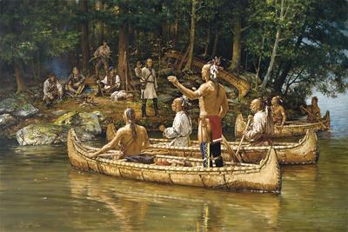
Native Americans of North America
Part 4
Northeastern Woodland Indians

Slide 2
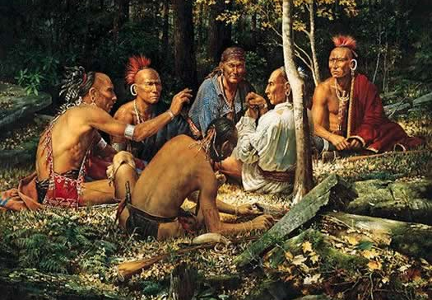
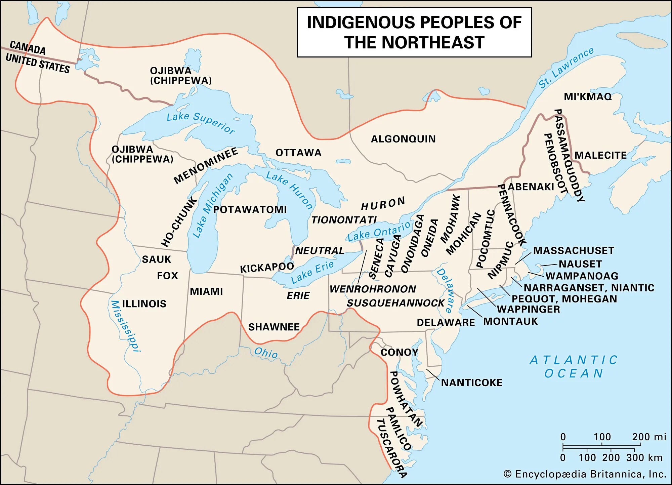
The tribes that live in what is now the northeastern part of the U.S. were a part of a group called the Eastern Woodland Indians, sometimes called Native Americans of the Northeast.

Slide 3
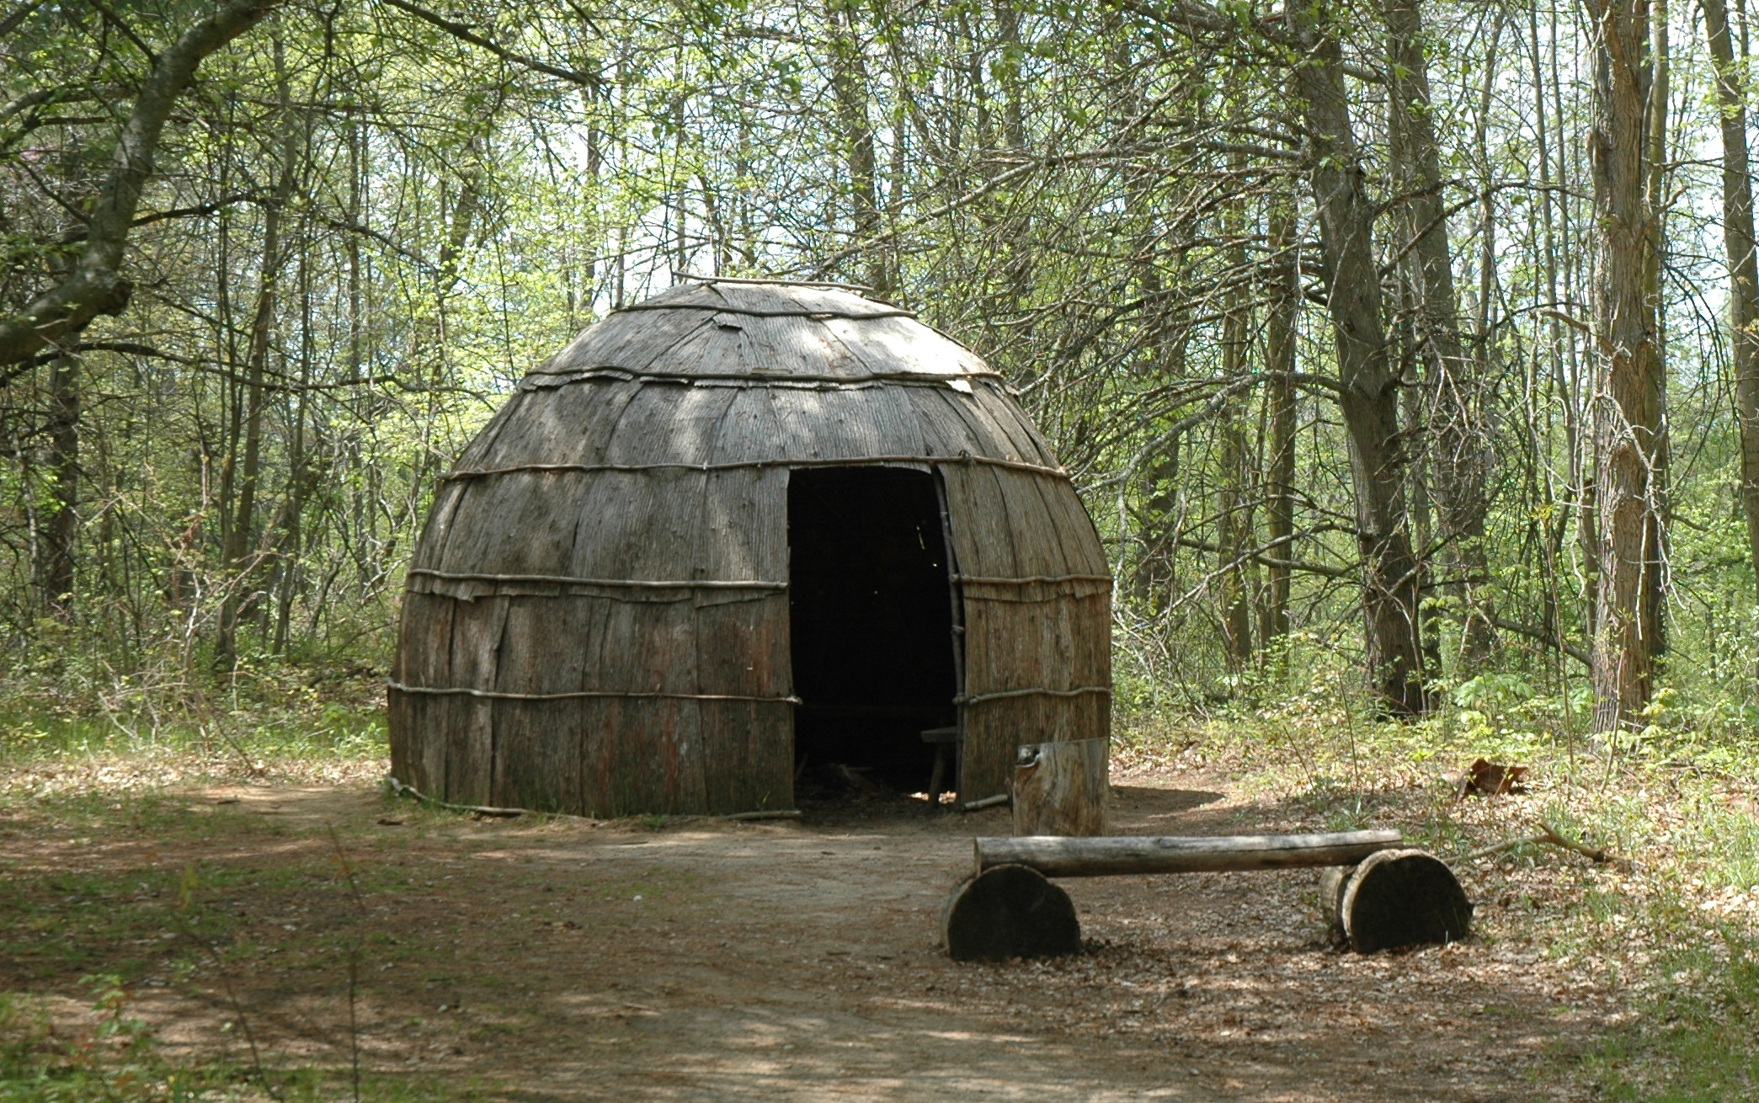
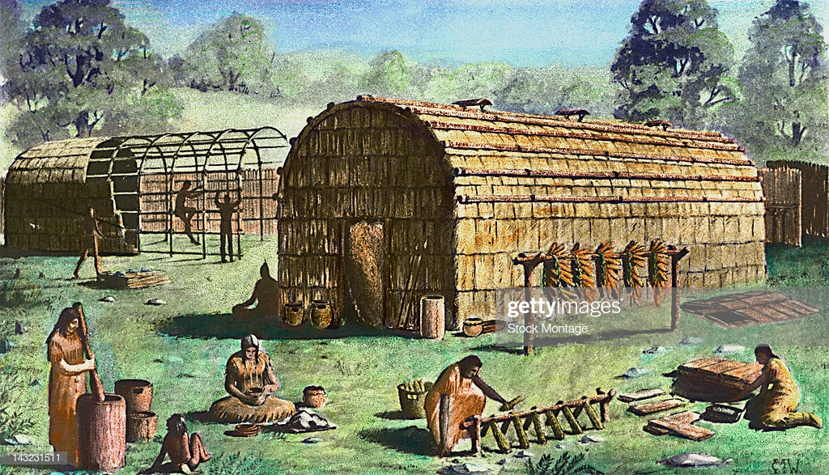
The Eastern Woodland Indians lived in homes made from small trees covered with bark.
These homes were called wigwams and longhouses.

Slide 4
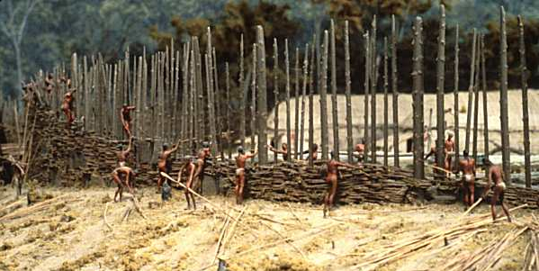
Some tribes build log walls, called palisades, around their villages for protection.

Slide 5
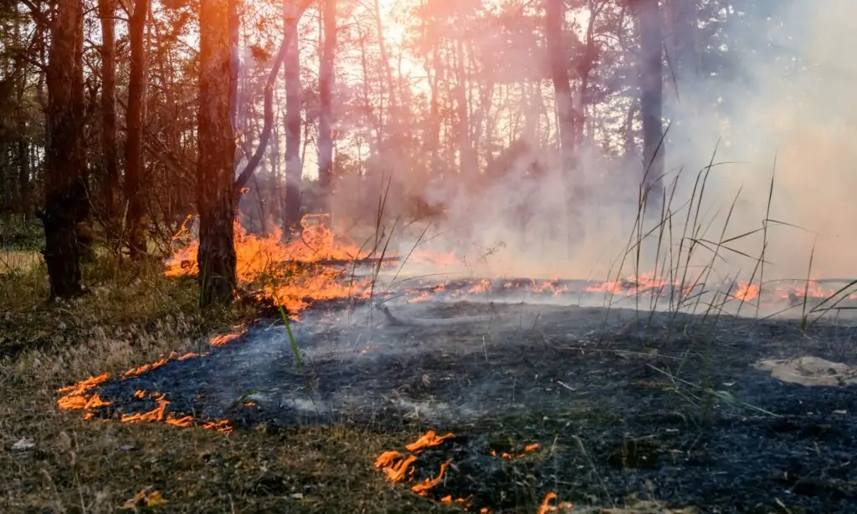
Native Americans of the Eastern Woodland tribes grew their own food. They practiced something called slash-and-burn agriculture to clear land for farming.

Slide 6
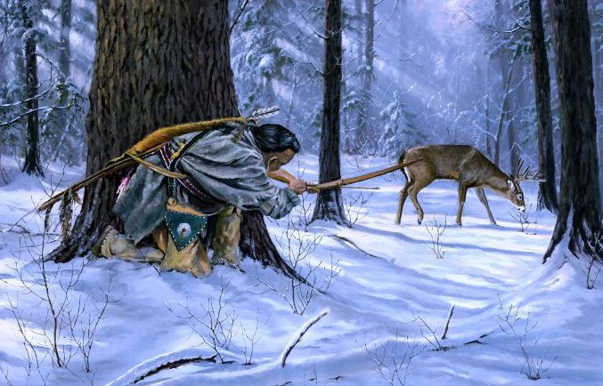
These Eastern Woodland Indians also hunted and fished for food.

Slide 7
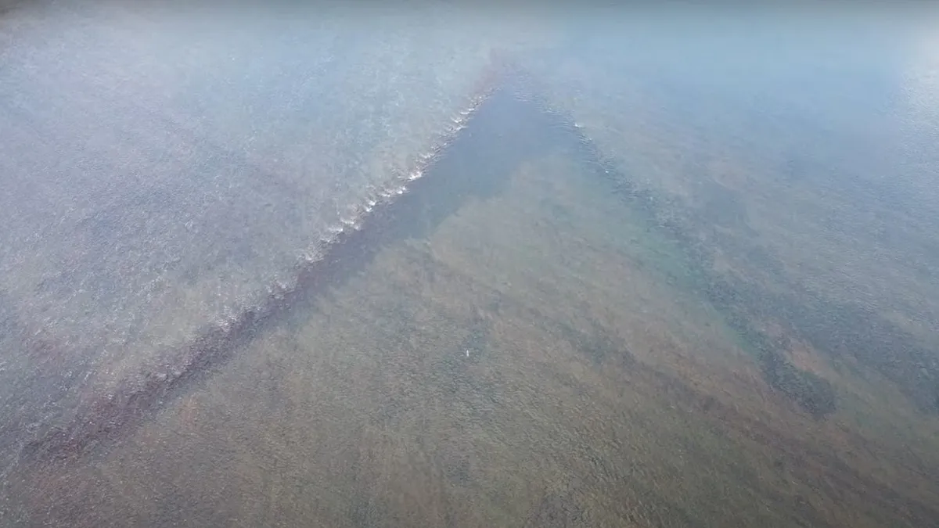
Eel Weir remains found in the Susquehanna River.

Slide 8
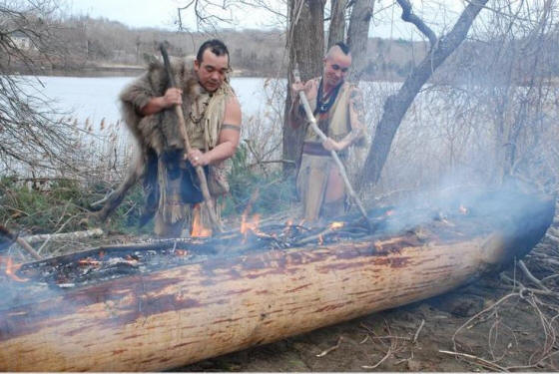
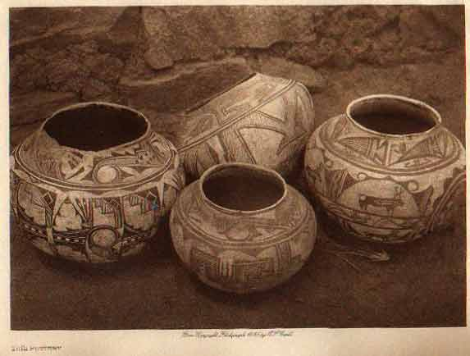
Eastern Woodland Indians built canoes from trees, made pottery from clay found in streams, and formed arrowheads and spearhead from stone.

Slide 9
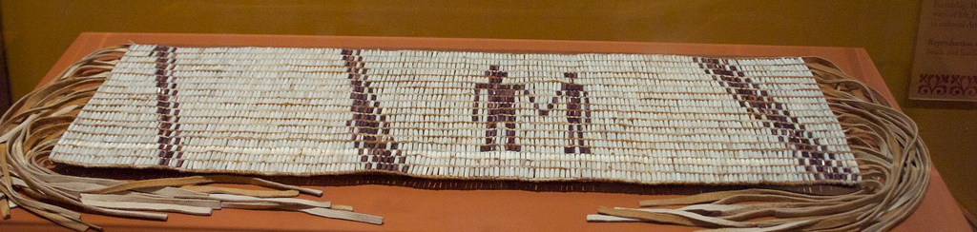
Many of these tribes used wampum belts to record their history, make treaties, and to send messages.

Slide 10
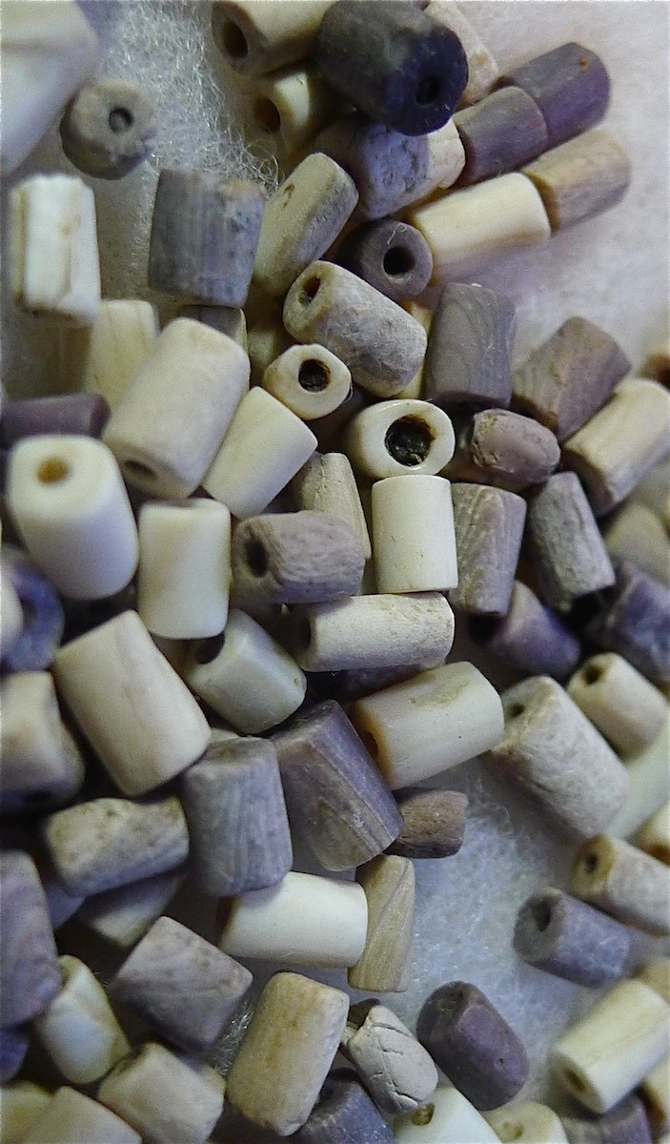

Wampum were beads made from wood, shells, or quills from porcupines or birds.

Slide 11


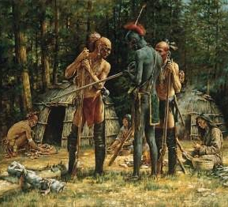



Most Eastern Woodland Indians belonged to either the Algonquin or Iroquoian language group.

Slide 12

The Iroquois League of Five Nations became one of the most powerful groups of Native Americans in North America.

Slide 13
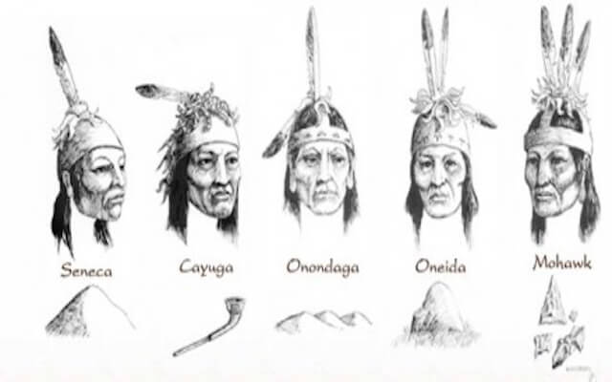
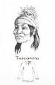
The Iroquois League of Five Nations was a group of five tribes working together for a common good. Those five tribes were the: Seneca, Cayuga, Onondaga, Oneida, and the Mohawk.
Later, the Tuscarora joined the Iroquois Nation.

Slide 14
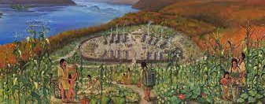
The Susquehannocks and Erie were other tribes that spoke the Iroquoian language.

Slide 15
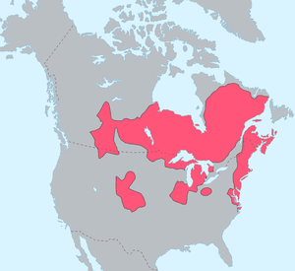
Tribes that spoke the Algonquian language included the Lenni Lenape, Wampanoag, Chippewa, Massachusett, Pottawatomie, Shawnee, and Cree.

